Slide 1



Slide 3
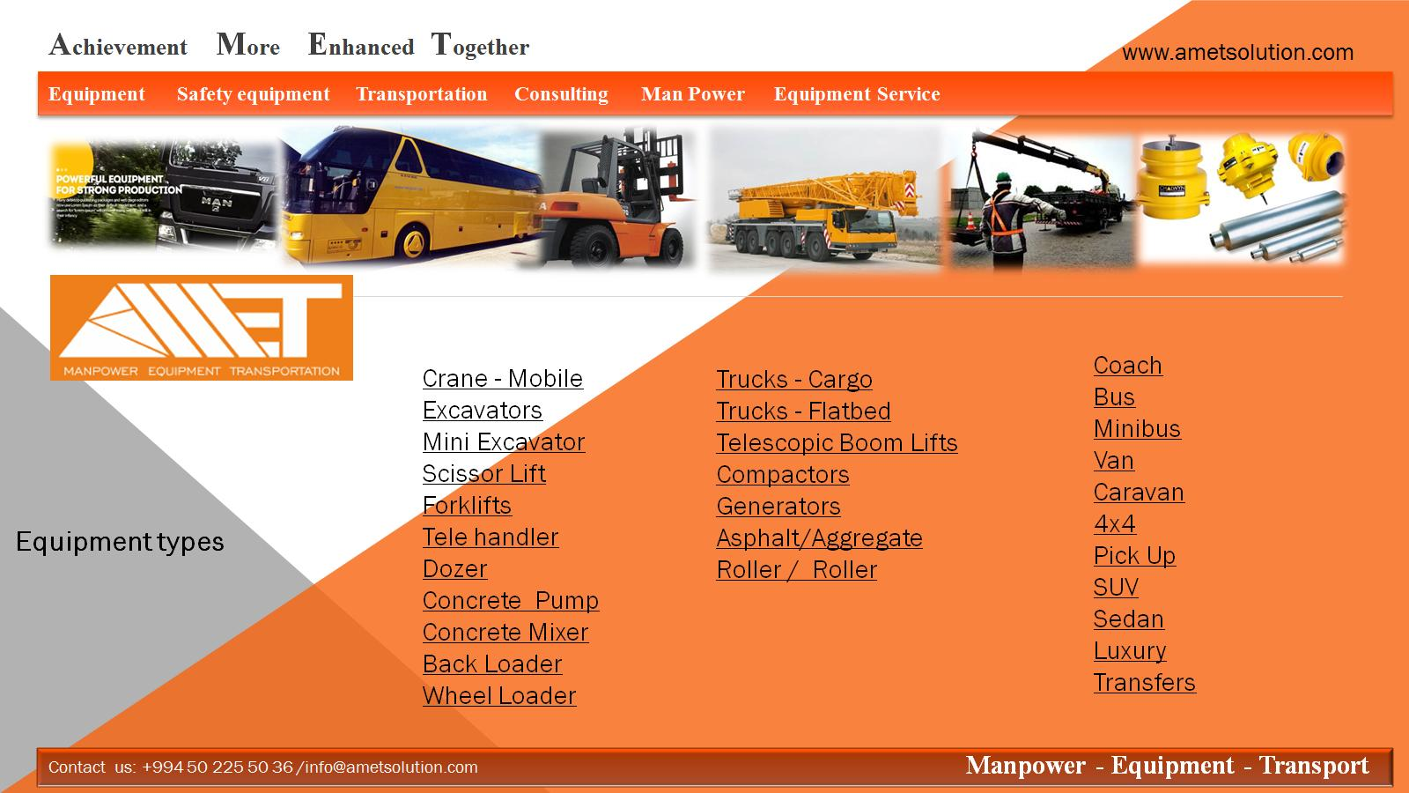

Slide 4


Slide 5
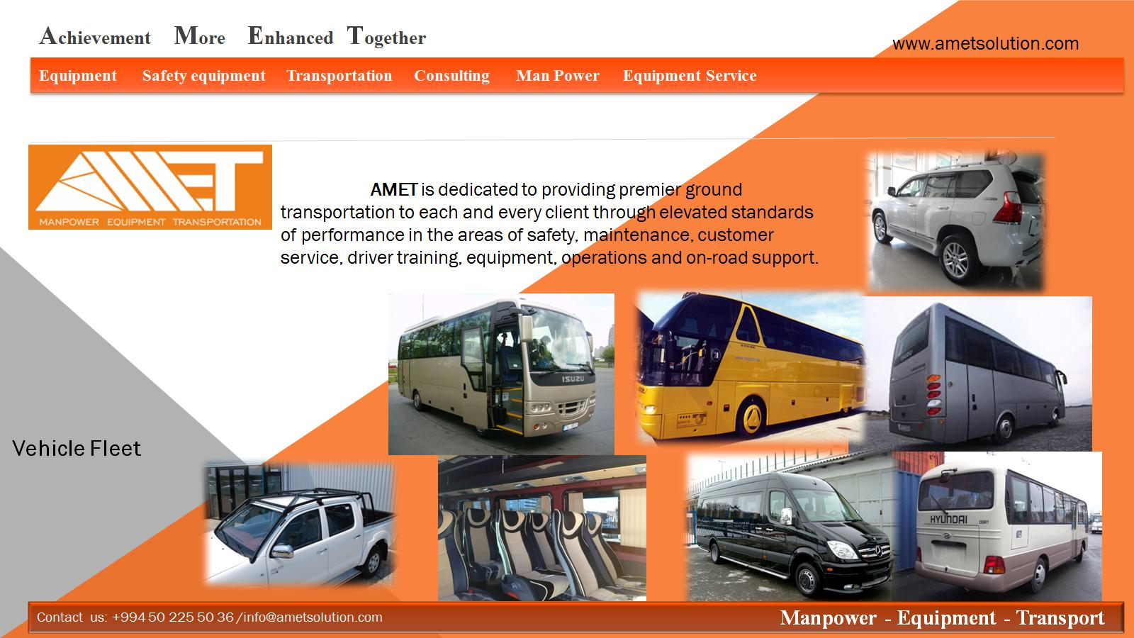

Slide 6


Slide 7


Slide 9











Slide 10

SOCAR- Ammonium plant
SOCAR-Polymer Plant
AzerSU-Damla Tower
BP AzSPU--ACG
Sagachal Terminal-EOP
Sangachal GAS Terminal SD2
SD2-ATA YARD
1st European Games National Olympic
Stadium
TANAP-Trans Adriatic Pipeline

Slide 11
S/S | Model | Type | Capacity | Lifting Height | YOM | QTY | Engine | Code
1 | JCB 540-140 | Telehandler | 4 000 | 14 | 2008 | 1 | Dizel | AM-E-001
2 | JCB 540-140 | Telehandler | 4 000 | 14 | 2012 | 1 | Dizel | AM-E-002
3 | Manitou MT1440 | Telehandler | 4 000 | 14 | 2006 | 1 | Dizel | AM-E-003
4 | Bobcat T40140 | Telehandler | 4 000 | 14 | 2009 | 2 | Dizel | AM-E-004
5 | JCB 535-140 | Telehandler | 3 500 | 14 | 2010 | 1 | Dizel | AM-E-005
6 | HELİ CPCD 70 | Forklift | 7 000 | 6 | 2011 | 3 | Dizel | AM-E-006
7 | HELİ CPCD 100 W5 | Forklift | 10 000 | 6 | 2011 | 3 | Dizel | AM-E-007
8 | HELİ CPCD 70 | Forklift | 7 000 | 3 | 2012 | 4 | Dizel | AM-E-008
9 | HELİ CPCD 50 | Forklift | 5 000 | 6 | 2012 | 5 | Dizel | AM-E-009
10 | HELİ CPCD 70 | Forklift | 7 000 | 6 | 2012 | 2 | Dizel | AM-E-010
11 | HELİ CPCD 30 | Forklift | 3 000 | 6 | 2012 | 6 | Dizel | AM-E-011
12 | TCM FD 160S-3EX | Forklift | 16 000 | 6 | 2012 | 2 | Dizel | AM-E-012
13 | DALIAN CPCD 50SX | Forklift | 5 000 | 4 | 2011 | 1 | Dizel | AM-E-013
14 | TCM FD 100 Z8 | Forklift | 10 000 | 3 | 2006 | 1 | Dizel | AM-E-014
15 | AISLE-MASTER 20SE | Forklift | 2 000 | 5 | 2008 | 2 | Elektrik | AM-E-015
16 | Komatsu FD50 | Forklift | 5 000 | 3 | 2006 | 1 | Dizel | AM-E-016
17 | HELİ CPD25 | Forklift | 2 500 | 5 | 2011 | 2 | Elektrik | AM-E-017
18 | TEU FD 100 T | Forklift | 10 000 | 4 | 2013 | 2 | Dizel | AM-E-018
19 | TEU FD 30 t | Forklift | 3 000 | 6 | 2013 | 4 | Dizel | AM-E-019
20 | JCB 540-140 | Forklift | 4 000 | 14 | 2011 | 1 | Dizel | AM-E-020
21 | JCB 540-140 | Forklift | 4 000 | 14 | 2013 | 1 | Dizel | AM-E-021
22 | JCB 540-170 | Forklift | 4 000 | 17 | 2011 | 2 | Dizel | AM-E-022
23 | JCB 540-170 | Forklift | 4 000 | 17 | 2012 | 1 | Dizel | AM-E-023
24 | JLG 4017 | Forklift | 4 000 | 17 | 2007 | 1 | Dizel | AM-E-024
25 | JLG3513 | Forklift | 4 000 | 17 | 2006 | 2 | Dizel | AM-E-025

Slide 12
26 | HYSTER H1.6FT | Forklift | 1, 600 |  | 2009 | 2 | Mazda LPG | AM-E-026
27 | HYSTER H2.OFTS | Forklift | 2 000 |  | 2007 | 1 | Mazda LPG | AM-E-027
28 | HYSTER H1.6FT | Forklift | 1, 600 |  | 2007 | 2 | Dizel | AM-E-028
29 | HYSTER H2.5 XM | Forklift | 2 500 |  | 2007 | 3 | Dizel | AM-E-029
30 | HYSTER E 2.50 XM | Forklift | 2 500 |  | 2007 | 1 | Electrical | AM-E-030
31 | HYSTER H3.OFT | Forklift | 3 000 |  | 2007 | 5 | Dizel | AM-E-031
32 | HYSTER J3 3.OXM | Forklift | 3 000 |  | 2009 | 1 | Electrical | AM-E-032
33 | HYSTER J3.2XM | Forklift | 3 200 |  | 2011 | 1 | Electrical | AM-E-033
34 | HYSTER J3.5 XM | Forklift | 3 500 |  | 2012 | 1 | Electrical | AM-E-034
35 | HYSTER H 3.5 FT | Forklift | 3 500 |  | 2007 | 1 | Dizel | AM-E-035
36 | HYSTER H4.OFT | Forklift | 4 000 |  | 2007 | 2 | Dizel | AM-E-036
37 | HYSTER H4.5 FT | Forklift | 4 500 |  | 2011 | 1 | Dizel | AM-E-037
38 | HYSTER H5.OFT | Forklift | 5 000 |  | 2008 | 4 | Dizel | AM-E-038
39 | HYSTER H5.OFT | Forklift | 5 000 |  | 2011 | 1 | Dizel | AM-E-039
40 | HYSTER H5.5FT | Forklift | 5 500 |  | 2007 | 6 | Dizel | AM-E-040
41 | HYSTER H8.OFT | Forklift | 8 000 |  | 2009 | 2 | Dizel | AM-E-041
42 | HYSTER H8.OFT | Forklift | 8 000 |  | 2013 | 1 | Dizel | AM-E-042
43 | HYSTER H10.OFT | Forklift | 10 000 |  | 2006 | 1 | Dizel | AM-E-043
44 | HYSTER H14.OFT | Forklift | 14 000 |  | 2006 | 1 | Dizel | AM-E-044
45 | HYSTER H14.5FT | Forklift | 14 000 |  | 2011 | 1 | Dizel | AM-E-045
46 | HYSTER H16.0FT | Forklift | 16 000 |  | 2011 | 2 | Dizel | AM-E-046
47 | HYSTER H16.0FT | Forklift | 16 000 |  | 2013 | 1 | Dizel | AM-E-047
48 | Still Forklift | Forklift |  |  | 2008 | 1 | Electrical | AM-E-048
49 | Reach Truck | Forklift |  |  | 2007 | 6 | Elektrik | AM-E-049
50 | Galichanin | Crane | 25 000 | 22 | 2010 | 1 | Dizel | AM-E-050
51 | XCMG QY25 K1 | Crane | 25 000 | 32 | 2011 | 2 | Dizel | AM-E-051
52 | XCMG QY25 K2 | Crane | 25 000 | 40 | 2010 | 1 | Dizel | AM-E-052

Slide 13
53 | XCMG QY50 | Crane | 50 000 | 42 | 2011 | 1 | Dizel | AM-E-053
54 | XCMG QY70 | Crane | 70 000 | 42 | 2011 | 1 | Dizel | AM-E-054
55 | Liebher LTM 1060 | Crane | 60 T | 42 | 2000 | 4 | Dizel | AM-E-055
56 | Liebher LTM 1090 | Crane | 90 T | 60 | 2001 | 4 | Dizel | AM-E-056
57 | Faun ATF 45 | Crane | 45 T | 40 | 2006 | 3 | Dizel | AM-E-057
58 | Kato | Crane | 20 | 35 | 1990 | 1 | Dizel | AM-E-058
59 | Dnepr | Crane | 25 | 24 | 1989 | 1 | Dizel | AM-E-059
60 | Yanvarec | Crane | 40 | 27 | 1992 | 1 | Dizel | AM-E-060
61 | Maz | Crane | 50 | 35 | 1993 | 1 | Dizel | AM-E-061
62 | Faun | Crane | 60 | 35 | 1983 | 1 | Dizel | AM-E-062
63 | HP | Crane | 75 | 42 | 1998 | 1 | Dizel | AM-E-063
64 | Grow | Crane | 90 | 44 | 1983 | 1 | Dizel | AM-E-064
65 | Tadano | Crane | 100 | 44 | 2005 | 1 | Dizel | AM-E-065
66 | Kato | Crane | 160 | 54 | 2006 | 1 | Dizel | AM-E-066
67 | Kato NK1200 | Crane | 120 | 50 | 2004 | 1 | Dizel | AM-E-067
68 | XCMG QY70 | Crane | 70 | 42 | 2012 | 1 | Dizel | AM-E-068
69 | GROVE GMK4070 | Crane | 70 | 40 | 1998 | 1 | Dizel | AM-E-069
70 | XCMG QY50 | Crane | 50 | 35 | 2012 | 1 | Dizel | AM-E-070
71 | GROVE RT745 | Crane | 45 | 30 | 1997 | 1 | Dizel | AM-E-071
72 | P&H E122 | Crane | 22 | 37 | 1997 | 1 | Dizel | AM-E-072
73 | XCMG QY25 | Crane | 25 | 39.5 | 2012 | 1 | Dizel | AM-E-073
74 | XCMG QY50 | Crane | 50 | 35 | 2012 | 1 | Dizel | AM-E-074
75 | Liebherr LTM1300-1 | Crane | 300 T | 114 | 2001 | 1 | Dizel | AM-E-075
76 | Liebherr LTM1160/2 | Crane | 160T | 60 | 2001 | 1 | Dizel | AM-E-076

Slide 14
Boom Lift and Scissor Lift
S/S | Model | Type | Capacity | Lifting Height | YOM | QTY | Engine | Code
1 | JLG 3246 ES | Scissors Lift |  | 10 | 2011 | 5 | Electrical | AM-E-88
2 | JLG E300 AJP | Boom Lift |  | 8 | 2011 | 6 | Electrical | AM-E-89
3 | JLG E450 AJ | Boom Lift |  | 15 | 2011 | 4 | Electrical | AM-E-90
4 | JLG 1200 SXJ | Boom Lift |  | 39 | 2011 | 6 | Dizel | AM-E-91
5 | JLG 1200 SJP | Boom Lift |  | 39 | 2006 | 6 | Dizel | AM-E-92
6 | JLG 800 AJ | Boom Lift |  | 27 | 2002 | 8 | Dizel | AM-E-93
7 | JLG 660 SJ | Boom Lift |  | 23 | 2013 | 6 | Dizel | AM-E-94
8 | JLG 450 AJ | Boom Lift |  | 16 | 2002 | 4 | Dizel | AM-E-95
9 | Nifty Cherry Picker |  |  |  | 2008 | 8 | Dizel | AM-E-96
10 | MAN L-2000\ Wumag wt 300 |  | 230 kg | 30 | 2000 | 1 | Dizel | AM-E-97
11 | MAN L-2000\ Wumag wt 300 |  | 230 kg | 30 | 2005 | 1 | Dizel | AM-E-98
12 | Mercedes-Bens 814 |  | 230 kg | 30 | 2006 | 1 | Dizel | AM-E-99
13 | Ruthmann TK- 310 |  | 230 kg | 32 | 2010 | 1 | Dizel | AM-E-100
Truck
S/S | Model | Type | Capacity | Lifting Height | YOM | QTY | Engine | Code
1 |  | Diesel Road Tanker |  |  | 2010 | 1 | Dizel | AM-E-101
2 | Truck with 40f flatbed | trailer |  | 40FT | 2009 | 15 | Dizel | AM-E-102
3 | Extendible Flatbed | trailer |  |  | 2009 | 1 | Dizel | AM-E-103
4 | Extendible Lowbed | trailer |  |  | 2009 | 1 | Dizel | AM-E-104
5 | Flatbed Truck |  |  | 7-10 T | 2006 | 2 | Dizel | AM-E-105
6 | Flatbed Truck |  |  | 3-5 T | 2006 | 1 | Dizel | AM-E-106
7 | 20`Skeleton | Trailer Kassbohrer |  | 28 T | 2008 | 20 | N/A | AM-E-107
8 | 13.60 Flatbed | Trailer Kassbohrer |  | 30 T | 2006 | 3 | N/A | AM-E-108
9 | ACTROS -Mercedes | 7 Metre Truck |  | 7 Ton | 2012 | 3 | Dizel | AM-E-109
10 | ACTROS -Mercedes | 7 Metre Truck |  | 7 Ton | 2013 | 2 | Dizel | AM-E-110
11 | Mersedes 4 x 2 |  |  | 3.5 T | 2000 | 2 | Dizel | AM-E-111

Slide 15
NN | Model | Type | Capacity | Standard | YOM | Engine | Code
1 | Mersedes-Trauega | Bus | 45 | EURO-5 | 2012 | Dizel | AM-V-001
2 | Mersedes-Trauega | Bus | 45 | EURO-5 | 2011 | Dizel | AM-V-002
3 | Mersedes-Trauega | Bus | 45 | EURO-5 | 2009 | Dizel | AM-V-003
4 | Mersedes-Trauega | Bus | 45 | EURO-5 | 2010 | Dizel | AM-V-004
5 | Mersedes-0403 | Bus | 46 | EURO-5 | 2011 | Dizel | AM-V-005
6 | Mersedes-0403 | Bus | 46 | EURO-5 | 2011 | Dizel | AM-V-006
7 | Mersedes-0403 | Bus | 46 | EURO-5 | 2012 | Dizel | AM-V-007
8 | Mersedes-0403 | Bus | 46 | EURO-5 | 2012 | Dizel | AM-V-008
9 | Mersedes-0403 | Bus | 46 | EURO-5 | 2012 | Dizel | AM-V-009
10 | Mersedes-0403 | Bus | 46 | EURO-5 | 2012 | Dizel | AM-V-010
11 | Setra | Bus | 48 | EURO-4 | 2005 | Dizel | AM-V-011
12 | Setra | Bus | 48 | EURO-4 | 2006 | Dizel | AM-V-012
13 | Setra | Bus | 48 | EURO-4 | 2006 | Dizel | AM-V-013
14 | Isuzu -Turkuaz | Bus | 31 | EURO-4 | 2008 | Dizel | AM-V-014
15 | Isuzu -Turkuaz | Bus | 31 | EURO-4 | 2006 | Dizel | AM-V-015
16 | Isuzu -Turkuaz | Bus | 31 | EURO-4 | 2011 | Dizel | AM-V-016
17 | Isuzu -Turkuaz | Bus | 31 | EURO-4 | 2013 | Dizel | AM-V-017
18 | Isuzu -Eurobus | Bus | 31 | EURO-4 | 2013 | Dizel | AM-V-018
19 | Isuzu -Eurobus | Bus | 31 | EURO-4 | 2011 | Dizel | AM-V-019
20 | Isuzu -Eurobus | Bus | 31 | EURO-4 | 2013 | Dizel | AM-V-020
21 | Isuzu -Eurobus | Bus | 31 | EURO-4 | 2011 | Dizel | AM-V-021
22 | Isuzu -Eurobus | Bus | 31 | EURO-4 | 2012 | Dizel | AM-V-022
23 | Isuzu -Eurobus | Bus | 31 | EURO-4 | 2011 | Dizel | AM-V-023
24 | Hyundai -County | Bus | 29 | EURO-4 | 2013 | Dizel | AM-V-024
25 | Hyundai -County | Bus | 29 | EURO-4 | 2013 | Dizel | AM-V-025
26 | Hyundai -County | Bus | 29 | EURO-4 | 2011 | Dizel | AM-V-026
27 | Hyundai -County | Bus | 29 | EURO-4 | 2013 | Dizel | AM-V-027
28 | Hyundai -County | Bus | 29 | EURO-4 | 2011 | Dizel | AM-V-028
29 | Hyundai -County | Bus | 29 | EURO-4 | 2012 | Dizel | AM-V-029
30 | Hyundai -County | Bus | 29 | EURO-4 | 2011 | Dizel | AM-V-030

Slide 16
31 | Otoyol | Bus | 29 | EURO-4 | 2013 | Dizel | AM-V-031
32 | Otoyol | Bus | 29 | EURO-4 | 2013 | Dizel | AM-V-032
33 | Mersedes-Sprinter | Minibus | 20 | EURO-5 | 2011 | Dizel | AM-V-033
34 | Mersedes-Sprinter | Minibus | 20 | EURO-5 | 2013 | Dizel | AM-V-034
35 | Mersedes-Sprinter | Minibus | 20 | EURO-5 | 2011 | Dizel | AM-V-035
36 | Mersedes-Sprinter | Minibus | 20 | EURO-5 | 2012 | Dizel | AM-V-036
37 | Mersedes-Sprinter | Minibus | 20 | EURO-5 | 2008 | Dizel | AM-V-037
38 | Mersedes-Sprinter | Minibus | 20 | EURO-5 | 2011 | Dizel | AM-V-038
39 | Mersedes-Sprinter | Minibus | 20 | EURO-5 | 2007 | Dizel | AM-V-039
40 | Mersedes-Sprinter | Minibus | 20 | EURO-5 | 2009 | Dizel | AM-V-040
41 | Mersedes-Sprinter | Minibus | 18 | EURO-5 | 2013 | Dizel | AM-V-041
42 | Mersedes-Sprinter | Minibus | 18 | EURO-5 | 2006 | Dizel | AM-V-042
43 | Mersedes-Sprinter | Minibus | 18 | EURO-5 | 2006 | Dizel | AM-V-043
44 | Mersedes-Sprinter | Minibus | 18 | EURO-5 | 2011 | Dizel | AM-V-044
45 | Mersedes-Sprinter | Minibus | 18 | EURO-5 | 2011 | Dizel | AM-V-045
46 | Mersedes-Sprinter | Minibus | 18 | EURO-5 | 2013 | Dizel | AM-V-046
47 | Mersedes-Sprinter | Minibus | 18 | EURO-5 | 2008 | Dizel | AM-V-047
48 | Mersedes-Sprinter | Minibus | 18 | EURO-5 | 2007 | Dizel | AM-V-048
49 | Mersedes-Sprinter | Minibus | 18 | EURO-5 | 2011 | Dizel | AM-V-049
50 | Mersedes-Sprinter | Minibus | 18 | EURO-5 | 2013 | Dizel | AM-V-050
51 | Mersedes-Sprinter | Minibus | 15 | EURO-5 | 2013 | Dizel | AM-V-051
52 | Mersedes-Sprinter | Minibus | 15 | EURO-5 | 2011 | Dizel | AM-V-052
53 | Mersedes-Sprinter | Minibus | 15 | EURO-5 | 2013 | Dizel | AM-V-053
54 | Ford-Transit | Minibus | 15 | EURO-4 | 2011 | Dizel | AM-V-054
55 | Ford-Transit | Minibus | 15 | EURO-4 | 2012 | Dizel | AM-V-055
56 | Ford-Transit | Minibus | 15 | EURO-4 | 2011 | Dizel | AM-V-056
57 | Ford-Transit | Minibus | 15 | EURO-4 | 2013 | Dizel | AM-V-057
58 | Ford-Transit | Minibus | 15 | EURO-4 | 2013 | Dizel | AM-V-058
59 | Hyundai-H1 | Minibus | 10 | EURO-4 | 2011 | Dizel | AM-V-059
60 | Hyundai-H1 | Minibus | 10 | EURO-4 | 2013 | Dizel | AM-V-060

Slide 17
61 | Hyundai-H1 | Minibus | 10 | EURO-4 | 2011 | Dizel | AM-V-061
62 | Hyundai-H1 | Minibus | 10 | EURO-4 | 2012 | Dizel | AM-V-062
63 | Hyundai-H1 | Minibus | 10 | EURO-4 | 2011 | Dizel | AM-V-063
64 | Hyundai-H1 | Minibus | 10 | EURO-4 | 2013 | Dizel | AM-V-064
65 | Hyundai-H1 | Minibus | 7 | EURO-4 | 2013 | Dizel | AM-V-065
66 | Hyundai-H1 | Minibus | 7 | EURO-4 | 2011 | Dizel | AM-V-066
67 | Hyundai-H1 | Minibus | 7 | EURO-4 | 2013 | Dizel | AM-V-067
68 | Hyundai-H1 | Minibus | 7 | EURO-4 | 2011 | Dizel | AM-V-068
69 | Hyundai-H1 | Minibus | 7 | EURO-4 | 2012 | Dizel | AM-V-069
70 | Mersedes-Viano | Minibus | 7 | EURO-5 | 2011 | Dizel | AM-V-070
71 | Mersedes-Viano | Minibus | 7 | EURO-5 | 2013 | Dizel | AM-V-071
72 | Mersedes-Viano | Minibus | 7 | EURO-5 | 2013 | Dizel | AM-V-072
73 | Mersedes-Viano | Minibus | 7 | EURO-5 | 2011 | Dizel | AM-V-073
74 | Mersedes-Viano | Minibus | 7 | EURO-5 | 2011 | Dizel | AM-V-074
75 | Mersedes-Viano | Minibus | 7 | EURO-5 | 2013 | Dizel | AM-V-075
76 | Mersedes-Viano | Minibus | 7 | EURO-5 | 2011 | Dizel | AM-V-076
77 | Mersedes-Viano | Minibus | 7 | EURO-5 | 2013 | Dizel | AM-V-077
78 | Mersedes-Viano | Minibus | 7 | EURO-5 | 2013 | Dizel | AM-V-078
79 | Mersedes-Viano | Minibus | 7 | EURO-5 | 2011 | Dizel | AM-V-079
80 | Mersedes-Viano | Minibus | 7 | EURO-5 | 2013 | Dizel | AM-V-080
81 | Mersedes-Viano | Minibus | 7 | EURO-5 | 2011 | Dizel | AM-V-081
82 | Toyoto Prado | 4x4 | 5 | EURO-4 | 2013 | Petrol | AM-V-082
83 | Toyoto Prado | 4x4 | 5 | EURO-4 | 2011 | Petrol | AM-V-083
84 | Toyoto Prado | 4x4 | 5 | EURO-4 | 2012 | Petrol | AM-V-084
85 | Toyoto Prado | 4x4 | 5 | EURO-4 | 2012 | Petrol | AM-V-085
86 | Toyoto Prado | 4x4 | 5 | EURO-4 | 2011 | Petrol | AM-V-086
87 | Toyoto Prado | 4x4 | 5 | EURO-4 | 2013 | Petrol | AM-V-087
88 | Toyoto Prado | 4x4 | 5 | EURO-4 | 2013 | Petrol | AM-V-088
89 | Mitsubishi Pajero | 4x4 | 5 | EURO-4 | 2011 | Petrol | AM-V-089
90 | Mitsubishi Pajero | 4x4 | 5 | EURO-4 | 2013 | Petrol | AM-V-090

Slide 18
91 | Mitsubishi Pajero | 4x4 | 5 | EURO-4 | 2011 | Petrol | AM-V-091
92 | Mitsubishi Pajero | 4x4 | 5 | EURO-4 | 2012 | Petrol | AM-V-092
93 | Mitsubishi Pajero | 4x4 | 5 | EURO-4 | 2012 | Petrol | AM-V-093
94 | Mitsubishi Pajero | 4x4 | 5 | EURO-4 | 2011 | Petrol | AM-V-094
95 | Mitsubishi Pajero | 4x4 | 5 | EURO-4 | 2013 | Petrol | AM-V-095
96 | Mitsubishi Pajero | 4x4 | 5 | EURO-4 | 2013 | Petrol | AM-V-096
97 | Hyunda Sonata | Sedan | 5 | EURO-4 | 2011 | Petrol | AM-V-097
98 | Hyunda Sonata | Sedan | 5 | EURO-4 | 2013 | Petrol | AM-V-098
99 | Hyundai Santafe | Sedan | 5 | EURO-4 | 2011 | Petrol | AM-V-099
100 | Hyundai Santafe | Sedan | 5 | EURO-4 | 2012 | Petrol | AM-V-100
101 | Hyundai Santafe | Sedan | 5 | EURO-4 | 2012 | Petrol | AM-V-101
102 | Kia Optima | Sedan | 5 | EURO-4 | 2011 | Petrol | AM-V-102
103 | Kia Optima | Sedan | 5 | EURO-4 | 2013 | Petrol | AM-V-103
104 | Kia Optima | Sedan | 5 | EURO-4 | 2013 | Petrol | AM-V-104
105 | Kia Optima | Sedan | 5 | EURO-4 | 2011 | Petrol | AM-V-105
106 | Mitsubishi L 200 | Pick-Up | 5 | EURO-4 | 2013 | Dizel | AM-V-106
107 | Mitsubishi L 200 | Pick-Up | 5 | EURO-4 | 2011 | Dizel | AM-V-107
108 | Mitsubishi L 200 | Pick-Up | 5 | EURO-4 | 2012 | Dizel | AM-V-108
109 | Mitsubishi L 200 | Pick-Up | 5 | EURO-4 | 2012 | Dizel | AM-V-109
110 | Mitsubishi L 200 | Pick-Up | 5 | EURO-4 | 2011 | Dizel | AM-V-110
111 | Mitsubishi L 200 | Pick-Up | 5 | EURO-4 | 2013 | Dizel | AM-V-111
112 | Mitsubishi L 200 | Pick-Up | 5 | EURO-4 | 2013 | Dizel | AM-V-112
113 | Mitsubishi L 200 | Pick-Up | 5 | EURO-4 | 2010 | Dizel | AM-V-113
114 | Mersedes-G class | 4x4 | 5 | EURO-5 | 2010 | Petrol | AM-V-114
115 | Mersedes- S class | Business class | 4 | EURO-6 | 2013 | Petrol | AM-V-115
116 | Mersedes- S class | Business class | 4 | EURO-6 | 2014 | Petrol | AM-V-116
117 | Mersedes- S class | Business class | 4 | EURO-5 | 2008 | Petrol | AM-V-117
118 | Mersedes- S class | Business class | 4 | EURO-4 | 2007 | Petrol | AM-V-118
119 | Mersedes- S class | Business class | 4 | EURO-4 | 2008 | Petrol | AM-V-119
120 | Mersedes- S class | Business class | 4 | EURO-5 | 2009 | Petrol | AM-V-120
121 | Mersedes- S class | Business class | 4 | EURO-5 | 2009 | Petrol | AM-V-121
122 | Mersedes- S class | Business class | 4 | EURO-5 | 2010 | Petrol | AM-V-122

Slide 19


